Slide 1
Jersey Part 1
For RESTFul application
(additional: jdbc, web, jpa)
Author: Pavel Vrublevskij

Slide 2
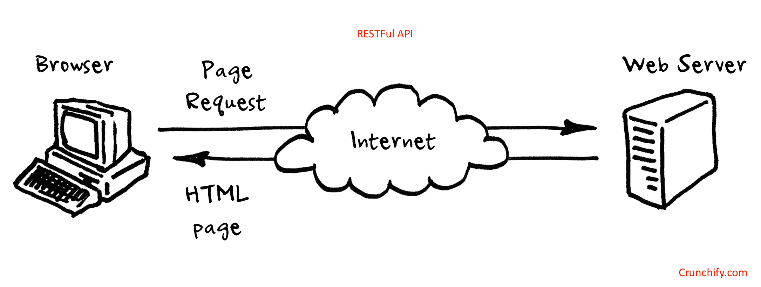

Slide 3
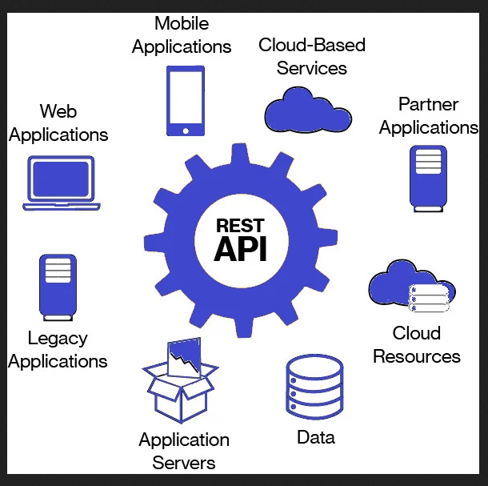

Slide 4
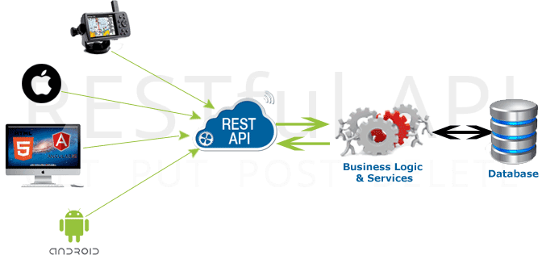

Slide 5
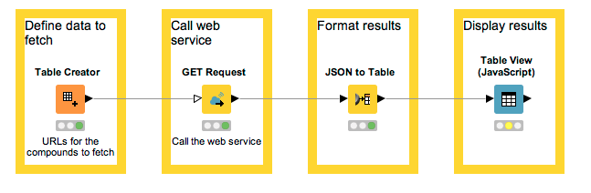
Our goal

Slide 6
RESTFul application
A RESTFul application follows the REST architectural style, which is used for designing networked applications. RESTful applications generate HTTP requests performing CRUD (Create/Read/Update/Delete) operations on resources. RESTFul applications typically return data in JSON or XML format.

Slide 7
JAX-RS
Java API for RESTful Web Services (JAX-RS) is a Java programming language API specification that provides support in creating web services according to the Representational State Transfer (REST) architectural pattern. JAX-RS uses annotations to simplify the development and deployment of web service clients and endpoints. JAX-RS is an official part of Java EE.

Slide 8
Jersey
Jersey is an open source framework for developing RESTful Web Services in Java. It is a reference implementation of the Java API for RESTful Web Services (JAX-RS) specification.

Slide 9
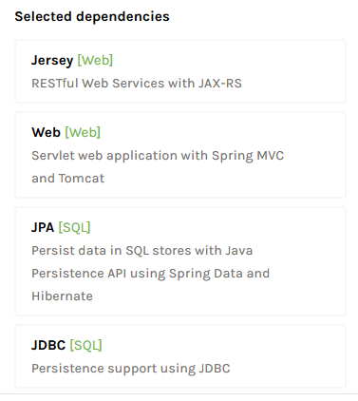
https://start.spring.io/
For project, we’ll need the dependencies:
spring-boot-starter-web
spring-boot-starter-jersey
spring-boot-starter-jpa
spring-boot-starter-jdbc

Slide 10
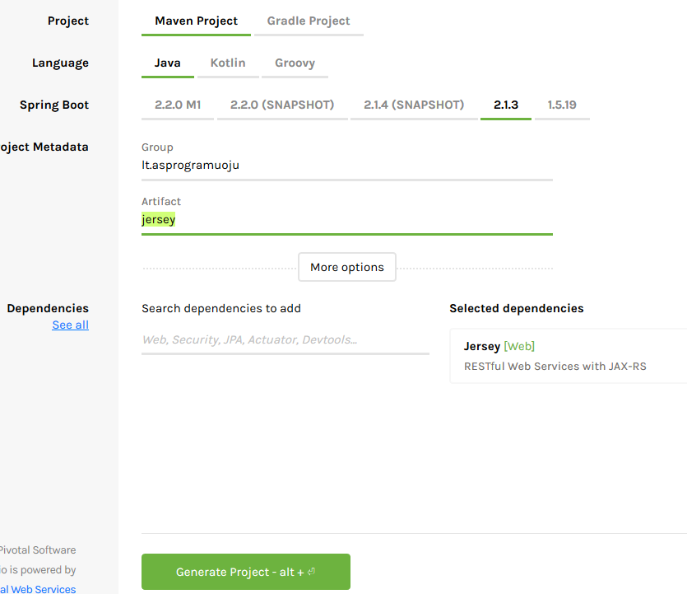
https://start.spring.io/
Maven
Java
2.1.3
Fill required filds
Search for Jersey
Extract downloaded zip file
to your project directory

Slide 11
@SpringBootApplication
The most straight-forward way to get started using Spring Boot is to create a main class and annotate
This single annotation is equivalent to using @Configuration, @EnableAutoConfiguration, and @ComponentScan.
By default, it will scan all the components in the same package or below
@SpringBootApplication public class JerseyApplication { public static void main(String[] args) { SpringApplication.run(JerseyApplication.class, args); } }

Slide 12

Create application.yml
server: port: 8086
servlet: context-path: /api
logging: level: org: springframework: ERROR

Slide 13
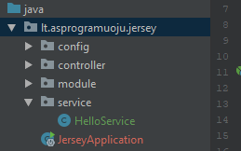
Create Hello Class Service
@Service @Path("/hello") public class HelloService { @GET @Produces("text/plain") public String hello() { return "Hello from Spring"; } }

Slide 14
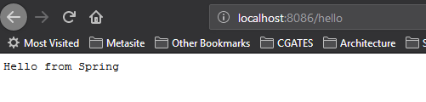
Run application

Slide 15
Download H2
https://www.h2database.com

Slide 16
Add to maven h2 and jdbc dependency
<dependency> <groupId>com.h2database</groupId> <artifactId>h2</artifactId> <version>1.4.197</version> <scope>runtime</scope> </dependency>
<!-- JDBC -->
<dependency> <groupId>org.springframework.boot</groupId> <artifactId>spring-boot-starter-jdbc</artifactId> </dependency>

Slide 17
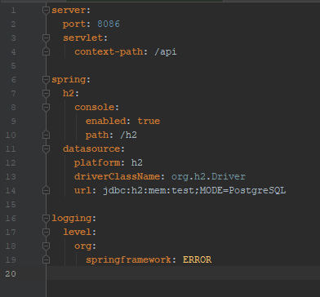
H2 and other ODBC required settings
Put to application.yml:
spring: h2: console: enabled: true path: /h2 datasource: platform: h2 driverClassName: org.h2.Driver url: jdbc:h2:mem:test;MODE=PostgreSQL

Slide 18

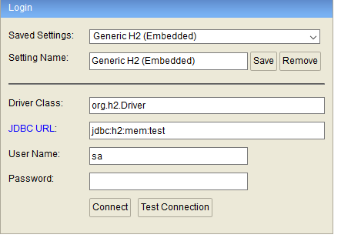
Introduce to H2
Visit
Will see:

Slide 19

Architectural pattern -MVC
M – Model
V – View
C – Controller
Usages:
commonly used for developing user interfaces
MVC – core of the solution

Slide 20
Architectural pattern -MVC
Model
The central component of the pattern.
It is the application's dynamic data structure, independent of the user interface.
It directly manages the data, logic and rules of the application.
View
Any representation of information such as a chart, diagram or table.
Multiple views of the same information are possible, such as a bar
chart for management and a tabular view for accountants.
Controller
Accepts input and converts it to commands for the model or view.

Slide 21
Architectural pattern -MVC
The model is responsible for managing the data of the application. It receives user input from the controller.
The view means presentation of the model in a particular format.
The controller responds to the user input and performs interactions on the data model objects. The controller receives the input, optionally validates it and then passes the input to the model.

Slide 22


Create Model
Create Person Class with ORM standarts
Put @Entity top on Class
Put data variables as example:

Slide 23
Add to maven required JPA dependency
...
...
...
<dependency> <groupId>org.springframework.boot</groupId> <artifactId>spring-boot-starter-data-jpa</artifactId> </dependency>
...
...
...
Import new dependencies

Slide 24
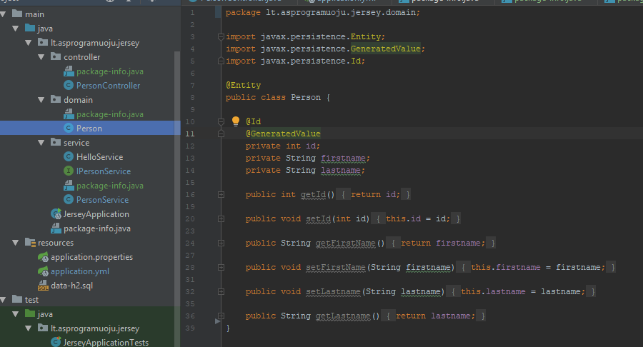
Result of Person domain
Don’t forget setters
and getters
When done, run your application and go to h2 by address

Slide 25
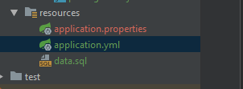
Auto DDL
Add JPA configurations to application.yml
Create also data.sql (data-h2.sql as file name is required for jpa as default name)
spring: # Spring Data JPA configuration jpa: hibernate: # To be updated in real production usage! ddl-auto: create-drop show-sql: true

Slide 26
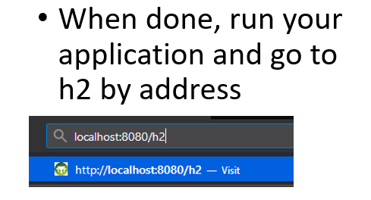

Slide 27
